Slide 1


Slide 2
Time | Topic
9:00 am | Welcome & attendance
9:30 am | Conflict Management/Problem-Solving skills
10:30 am | The Cover Letter
11:00 am | The Resume
12:00 pm | Lunch
1:00 pm | Peer to peer resume review
2:00- 4:00 pm | LST resume reviewing

Slide 3
Behavioral interview questions
What is it that interests you in this position/or with this company?
Describe a time when you volunteered to expand your knowledge either at work or in your personal life, as opposed to being directed to do so?

Slide 4

Conflict Management
Help us define Conflict Management.
Introduce the management styles
Why is it important to know how you deal with conflict?
What is your personal style of Conflict Management?
Notes:
https://www.peoplehum.com/glossary/conflict-management#

Slide 5

Common Conflict Management Styles
Collaborating (Problem Solver)
Both Parties win.
Competing
One party seeks to satisfy interest regardless of impact to the other party.
Avoiding
One of both parties seek to suppress the conflict.
Accommodating
One party yields the win to the other party.
Compromising
Both parties win and give up something.

Slide 6
Best Practices
Be aware of conflict.
Take a considerate and rational approach to conflict.
Investigate the situation.
Let everyone have their say.
Identify options and agree on a way forward.
Implement the agreed option and evaluate how it is going.
Consider preventative strategies for the future.

Slide 7
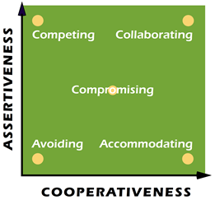
Thomas-Kilmann Instrument
The Thomas-Kilmann Instrument is designed to measure a person’s behavior in conflict situations. “Conflict situations” are those in which the concerns of two people appear to be incompatible.
In such conflict situations, we can describe an individual’s behavior along two dimensions: (1) assertiveness, the extent to which the person attempts to satisfy his own concerns, and (2) cooperativeness, the extent to which the person attempts to satisfy the other person’s concerns.
These two underlying dimensions of human behavior (assertiveness and cooperativeness) can then be used to define five different modes for responding to conflict situations:

Slide 8
Conflict Management
Complete the Conflict Styles Assessment from Thomas-Kilmann. Each question will present you with two options- choose the one that’s the best fit. There aren’t any right or wrong answers.
Conflict Styles Assessment
https://www.usip.org/public-education-new/conflict-styles-assessment

Slide 9
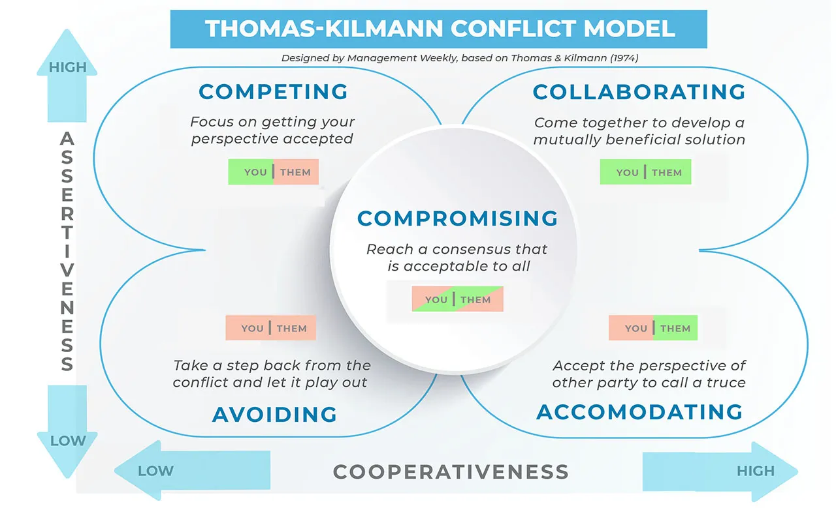
From Management Weekly

Slide 10
Problem-Solving Skills
Problem Framing
We often jump into problem-solving without evaluating the problem itself.
Ways to reframe problems:
“How might we” questions - transform problems into opportunities.
Worst Case scenarios – everything that could go wrong becomes innovation (proactive)

Slide 11
Problem-Solving Skills/Problem Framing
Rose, thorn, bud – visualizing data as (positive), (negative), and (opportunity).
Working backwards – follow the steps it took to become the problem.

Slide 12
How to Problem Solve
Steps to improve your problem-solving?
Define the problem
Diagnosing the root cause
Identifying and implementing a solution
Sustaining results
In the classroom, name some problem-solving skills for the whiteboard!
Notes:
Skills examples: creativity, communication, teamwork, clarity, decision-making, planning, reflection, examples of other problems, leadership, accountability, experience, calmness, listening skills, pivoting.

Slide 13
Digital Badges from Education Design Lab
Notes:
Preparing the class for the assessment next week during CD class. (Oral Communication)

Slide 14
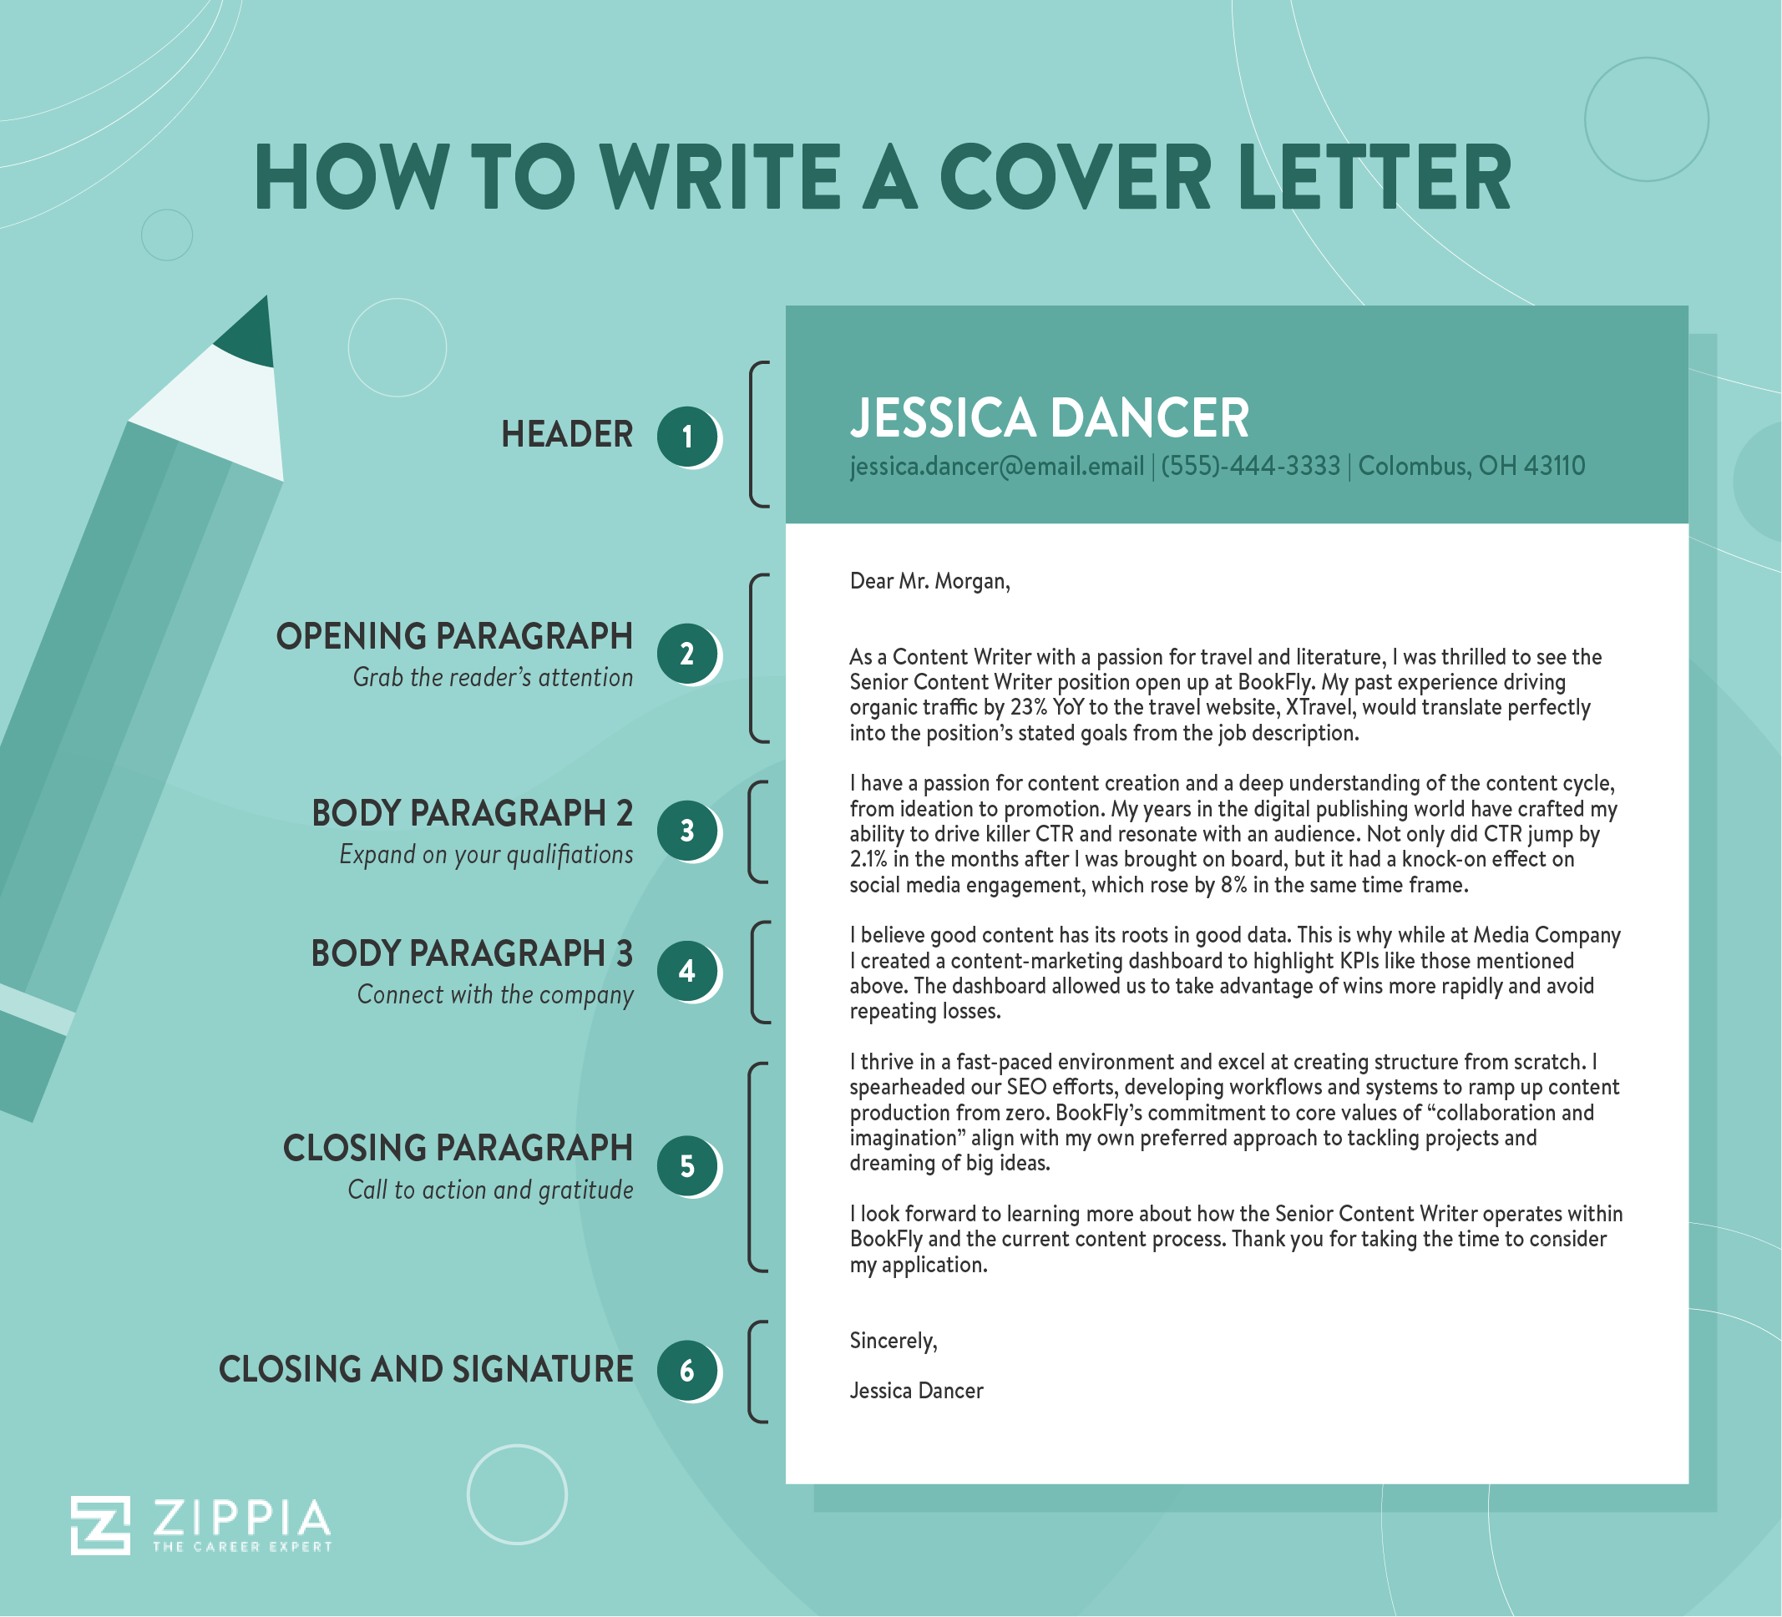

Slide 16
Matching cover letter to job descriptions
Use a typical job description from Indeed or the Workday mock job description to prompt ChatGPT for this exercise.
Now we will open ChatGPT and demonstrate how to create the cover letter.
https://chat.openai.com/

Slide 17




Your Resume
Demonstrate your Capabilities
Market yourself
Show off your skills, accomplishments, and prove why you’re the best person for the job
Keep it simple
Use bullets vs paragraphs to provide an overview of your accomplishments
Smart Wording
Utilize strong action verbs that quantify (where possible) and emphasize results (e.g., enhanced, influenced, and attained)
Proofread
Proofread your resume and ask a friend to review it, as well
Notes:
Your resume is your personal marketing brochure. Recruiters take an average of 30-60 seconds to review a resume and your goal is to demonstrate that you’re the best person for the job with your skills and accomplishments.
You’re marketing yourself- list your skills, accomplishments, and prove why you’re the best person for the job
Keep it simple: Use bullet points vs paragraphs and make sure your resume is clear, professional, and easy to read
When you can, use words and phrases that show results.
Always proof-read your resume and have someone else proof-read it as well- the last thing you want is a grammatical error

Slide 18
CAR vs the others
CAR – Challenge/Action/Results
STAR – Situation/Tasks/Action/Results
SOAR –Situation/Objective/Action/Results

Slide 19
Instruction
CAR – Challenge, Action, and Results
CAR statements are powerful because they show clear examples of you making a difference for your past employers. Achievement statements give potential employers a chance to see your professional competencies, strengths, and skills. We’re taking skills you already possess and marketing them in a way to get you the best opportunity possible.
Challenge – You faced in your professional work
Action- You took to resolve the problem
Results- You achieved for the organization
Notes:
STATE: As you begin documenting your achievements/responsibilities for previous jobs, here are some questions you can think about:
Did you solve a recurring problem for your department?
Did you suggest any new procedures or programs for your company?
Did you make your job easier or more efficient?
Did you train anyone?
Did you implement a new procedure or system?
Did you do a job with fewer people or in less time?
Did you help increase sales?
Did you save the company money?
In each bullet, try to think of anything “IT RELATED” that you did. That will make it more impactful, even if the job was IT.
STATE: Before you advertise this in your profile or summary of qualifications, be sure you can prove it.

Slide 20

Let’s talk about CAR!
C : Challenge
It doesn't matter if you work in construction, service industry, payroll, or sales — all companies have their own sets of issues that they look to their employees to help solve. For each job that you have listed on your resume, think about the tasks you were given. Each task is, in other words, a problem — something that hasn't been done that needs to be done. By doing the task, you'll be solving some issues for the company.
Example:
The Number of donors for the Colorado DCPA was 35% lower than anticipated.

Slide 21
Let’s talk about CAR!
A : Action
Now you've established that you oversaw handling a problem. What did you do about it? What strategy did you put in place to tackle the problem and why? Did you implement new policies? Did you cut wasteful spending? The key to “Action” is keeping it short and sweet. You only have so much room on your resume, and of the three items in the C.A.R. formula, the action should get the least amount of attention. Be concise and simply state what you did to improve the situation.
Example:
I initiated a phone call/email campaign of past members. (over the third quarter)

Slide 22

Let’s talk about CAR!
R : Results
This is what prospective employers really want to see. Sure, you were faced with a problem and produced a plan to address it, but how did you do? They don't want to hear that it “went well.” They want to see quantifiable results. Numbers look good here.
Example:
By calling inactive members, I increased renewal by 22%. (in the fourth quarter)
Putting it all together:
(Challenge) The Colorado DCPA had poor communication with its donors, its customers, and the public. (Consequences) the organization failed to grow and meet its strategic goals. (Action) I created an electronic newsletter and permission-based email system. (Result) We increased the number of donors by 22 percent.

Slide 23
Resume class activity
Now that we have gone over resumes take out your resume and partner with another student, read each other’s resume, and give constructive feedback. Pay close attention to these things:
How does it look? Style - (colors, font, design)
Does the summary help flesh out the person?
No mistakes (grammar, spelling)
CAR bullets under work experience?

Slide 24
Let AI help you build your Resume.
An AI resume builder is an innovative tool that can help job seekers create a standout resume in a matter of minutes. These tools use artificial intelligence and machine learning technology to simplify resume-building, making it less stressful and more efficient.
With a typical AI resume builder, you get the following:
Customizable resume templates to ease your search for the best-looking resumes
Content suggestions based on your job profile to create tailored resumes specific to your career goals and objectives
Automatic formatting options further simplify the process, allowing job seekers to focus on the content of the resume while the tool takes care of the design
Keyword optimization to make your resume ATS-friendly and easily searchable by recruiters

Slide 25
Let AI help you build your Resume.
ChatGPT-
ChatGPT is built on natural language processing (NLP). In short, the bot is trained to understand text the way humans do. It “learns” through the use of data sets or large amounts of information that “teach” the AI how to recognize patterns. From that training, the AI learns how to craft a response that seems relatively life-like
Sites:
Zety Resume Builder - https://zety.com/resume-builder
Resume-Now - https://www.resume-now.com/
Rezi AI Resume Builder - https://www.rezi.io/
Kickresume – https://www.kickresume.com/en/
Teal - https://www.tealhq.com/

Slide 26
Resume Example:

Slide 27
Resume Example:

Slide 28

EDL Survey

Slide 29
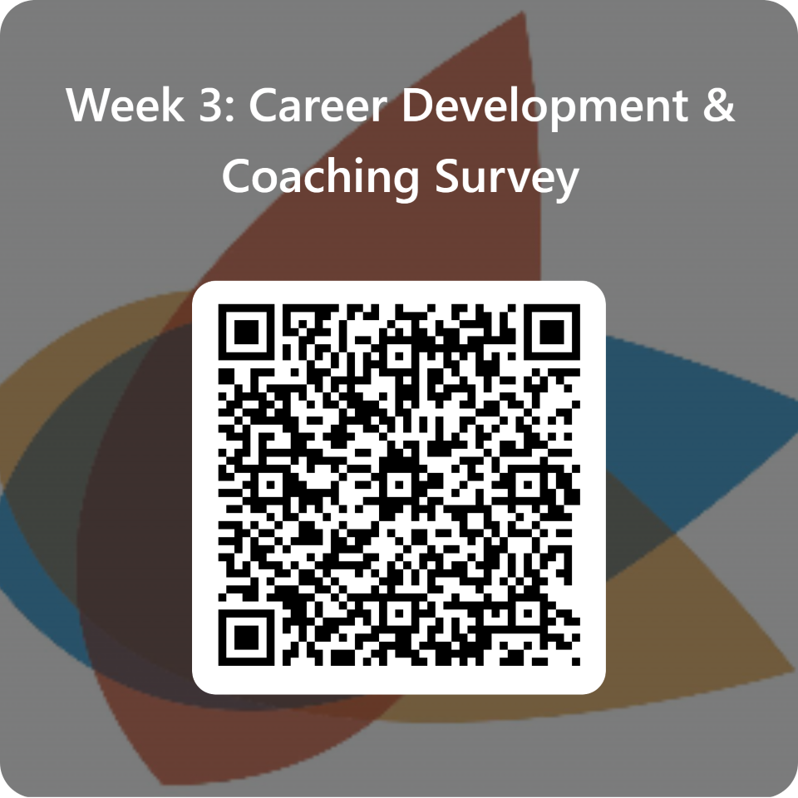
End of class Survey.

Slide 30
Assignments
Work on your resume, bring it to a 2nd draft
EDL assessment in class next week

